Slide 1
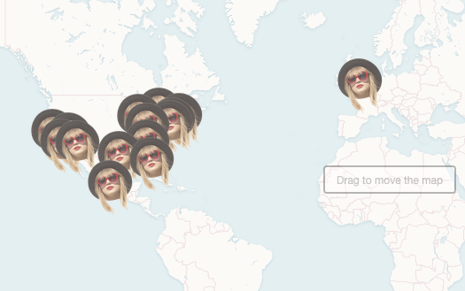

This is data journalism
@PaulBradshaw
Birmingham City University #bcujournos

Slide 2
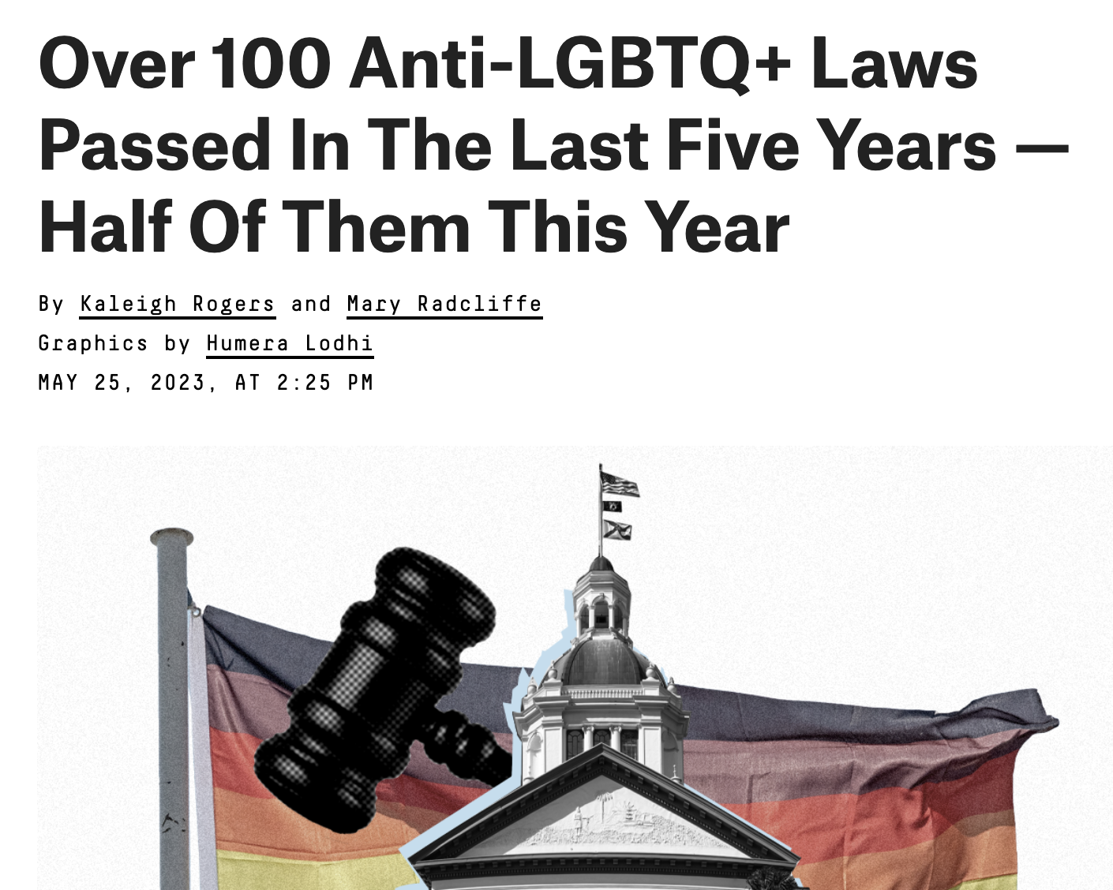
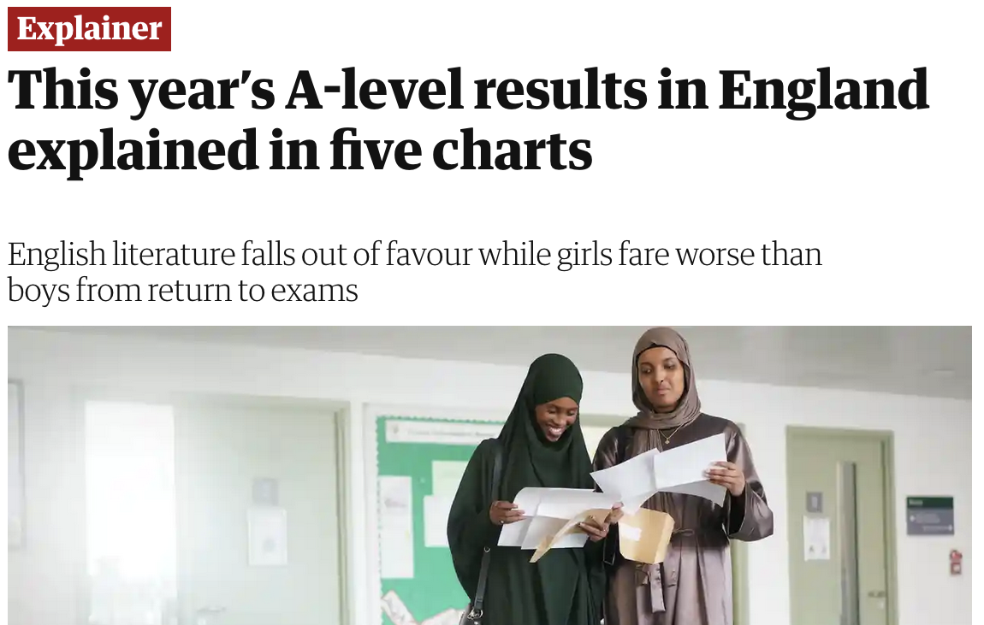
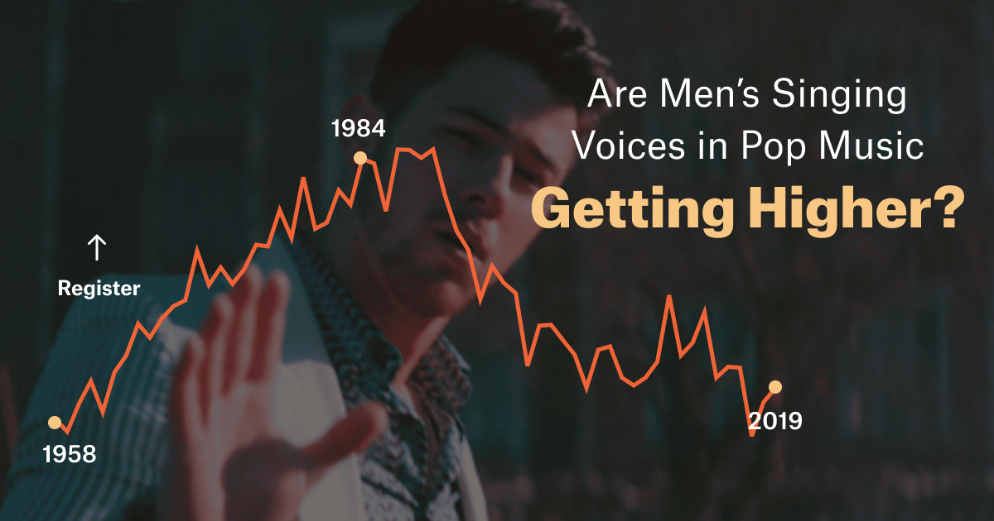
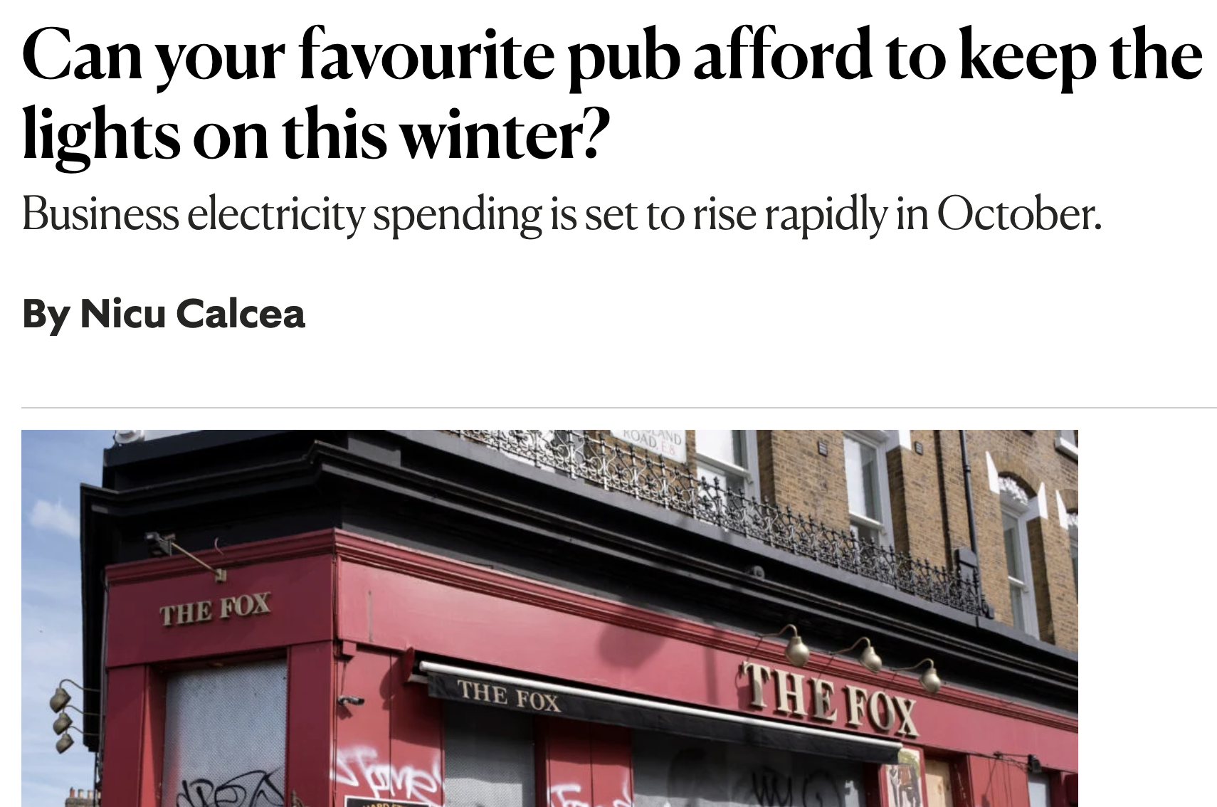
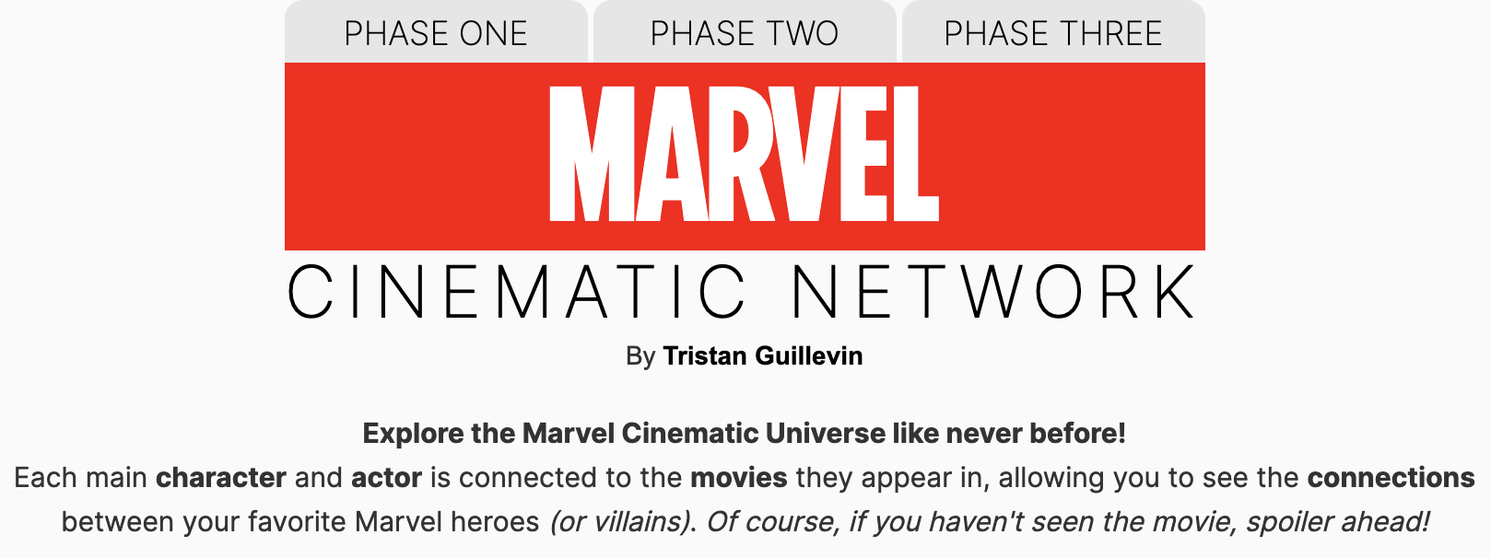

Slide 3
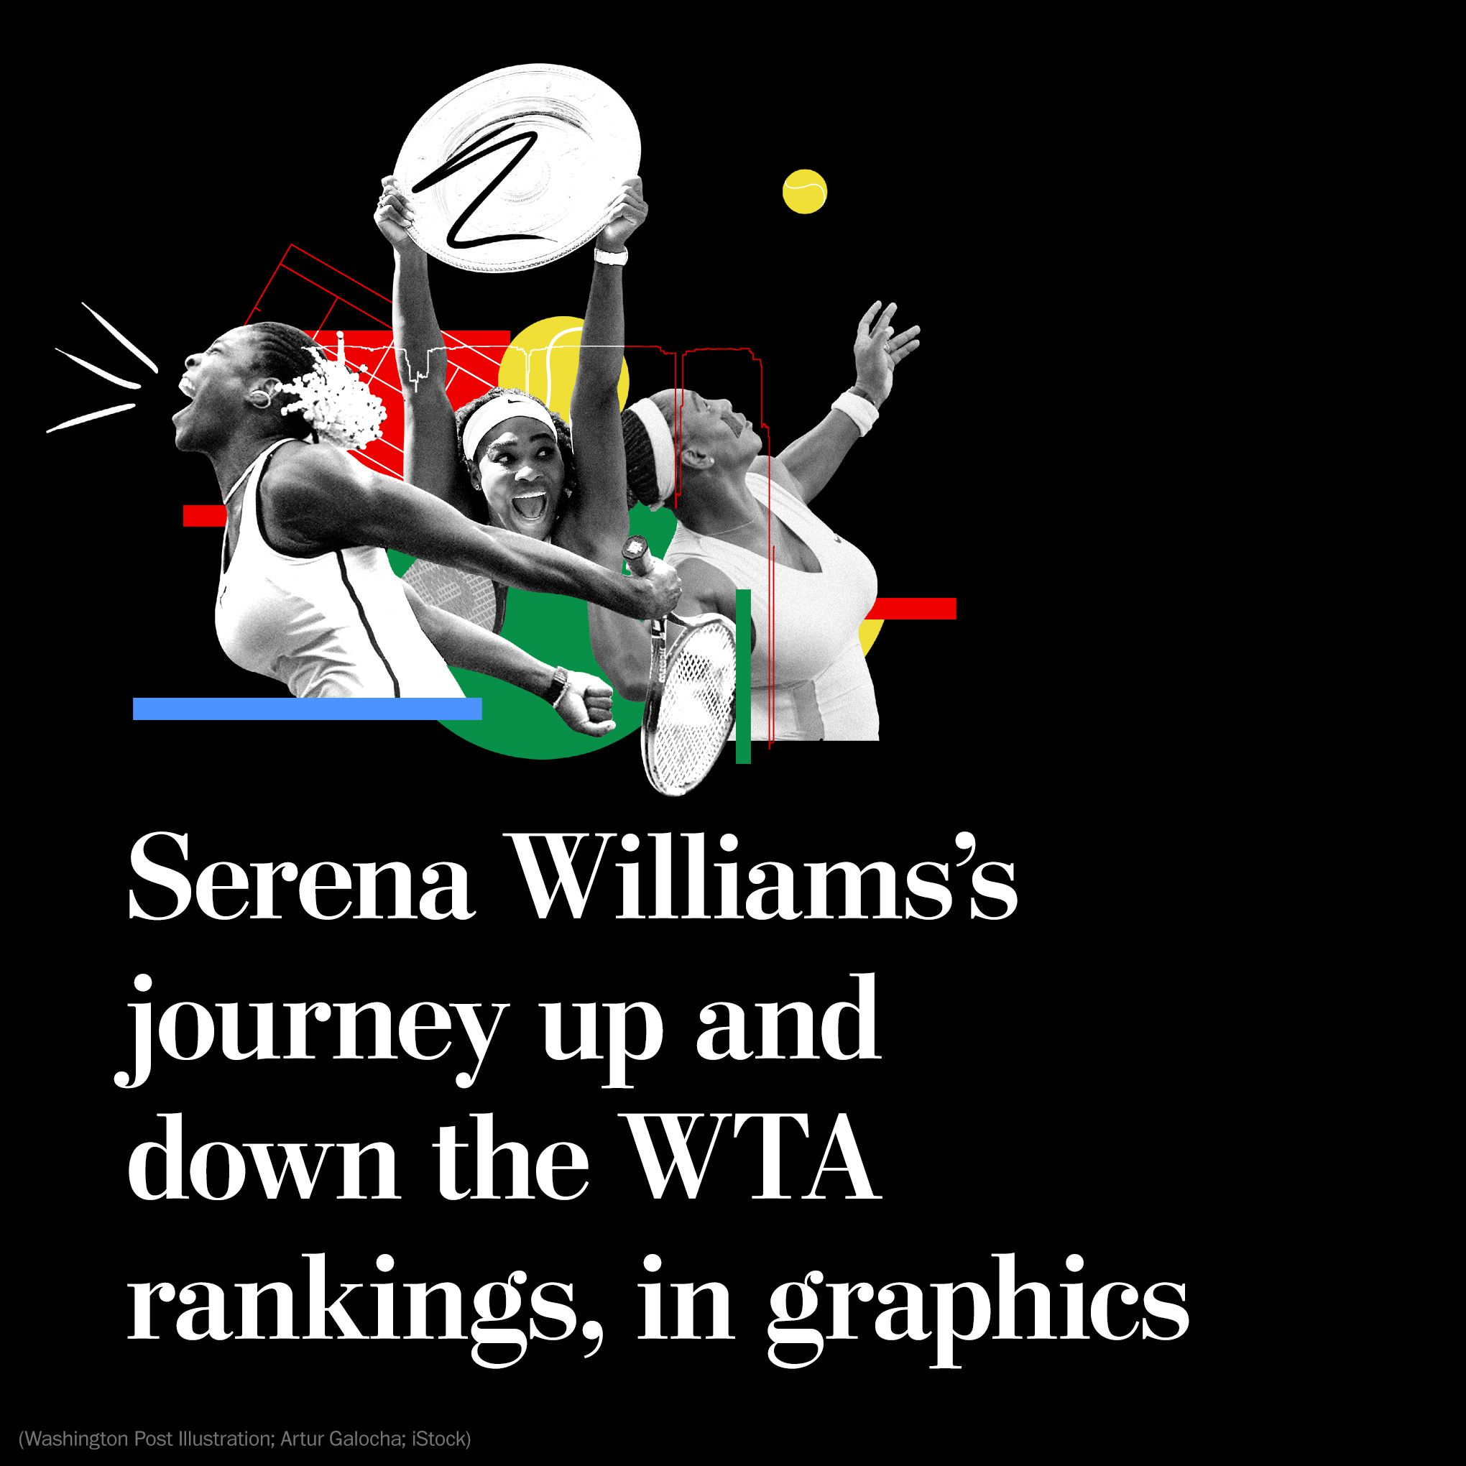
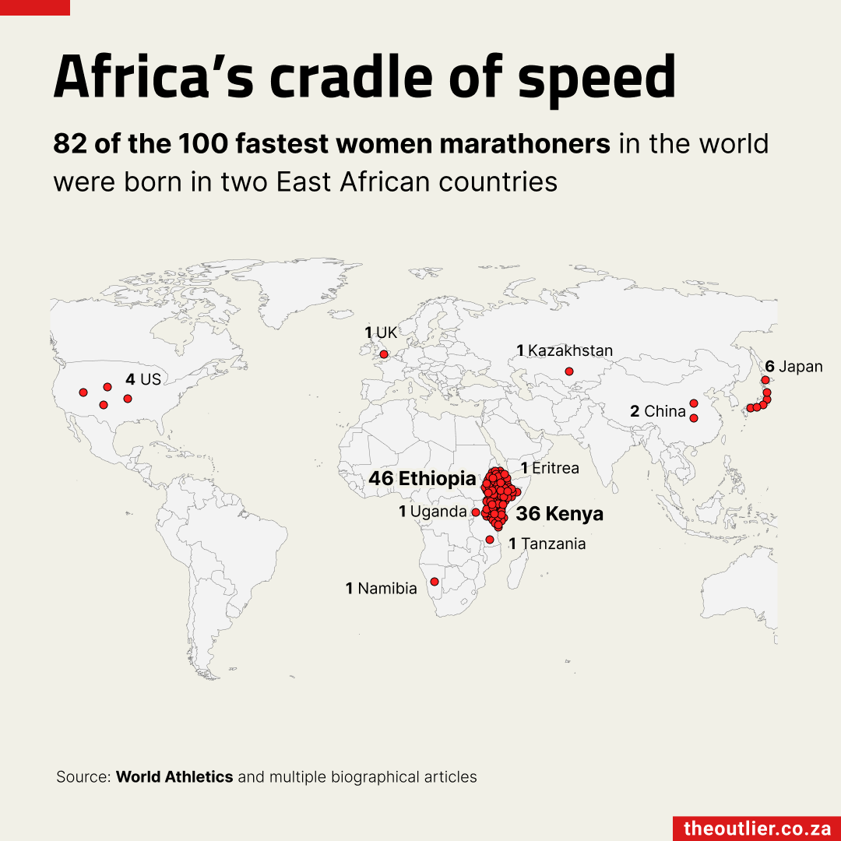
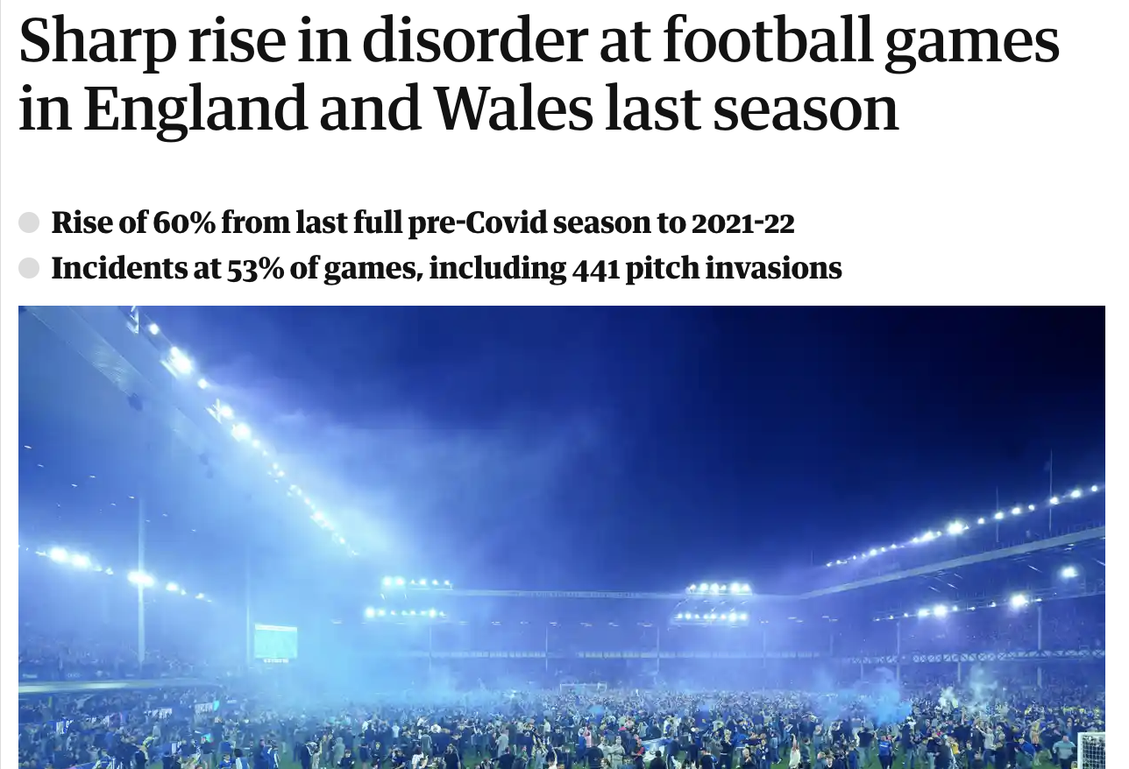
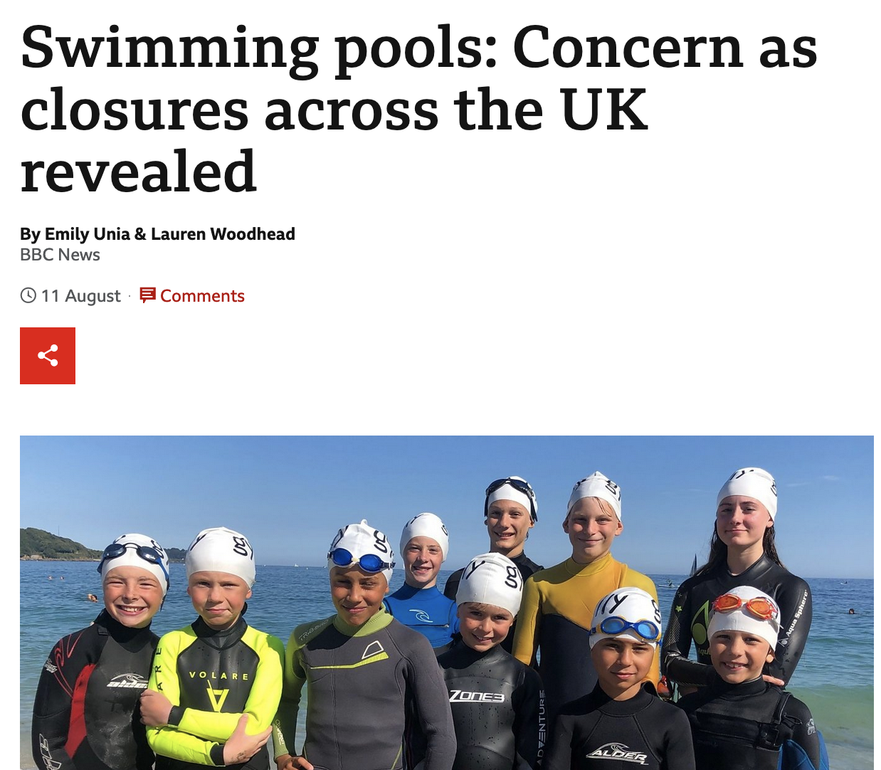
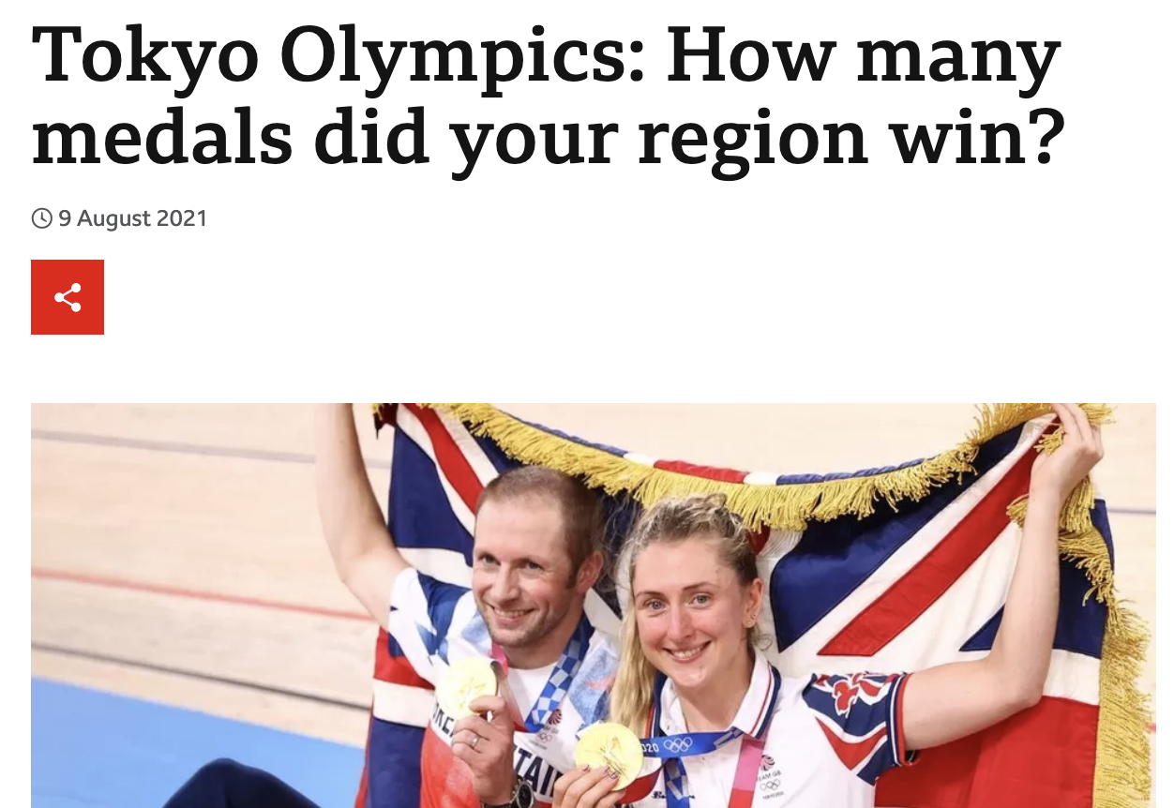

Slide 4
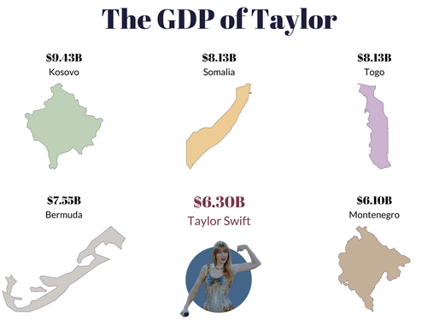
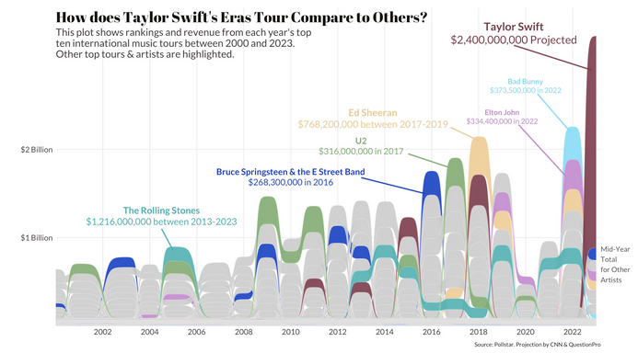
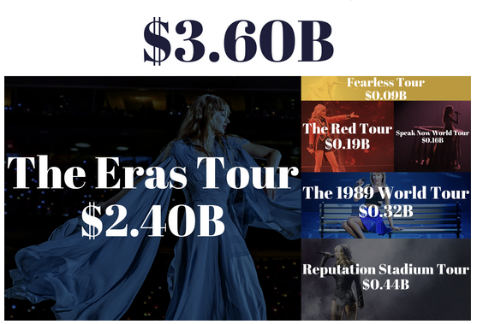
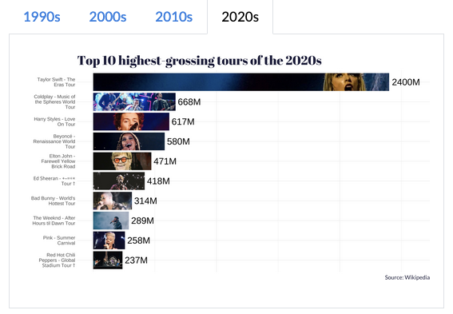
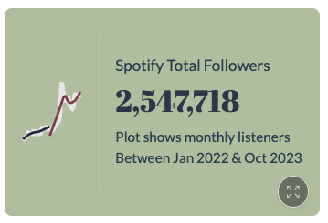
https://colorado.posit.co/rsc/tay-swift-tour/

Slide 5
Scrollytelling:
Can 95 years of data tell us who will win this year’s Oscar for best picture? (former student!)
Red Means Stop: Better Streets for Birmingham
George Willoughby: Police diversity (student!)
Bloomberg: Ill in England? Your Location Can Determine If You Live or Die
AP: Through four wars, toll mounts in a Gaza neighborhood
ESPN: Inside US Open champion Carlos Alcaraz's game

Slide 6
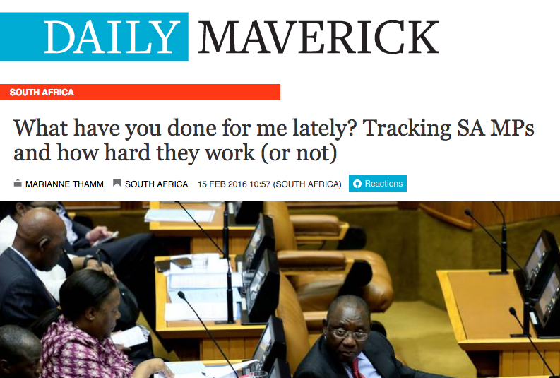
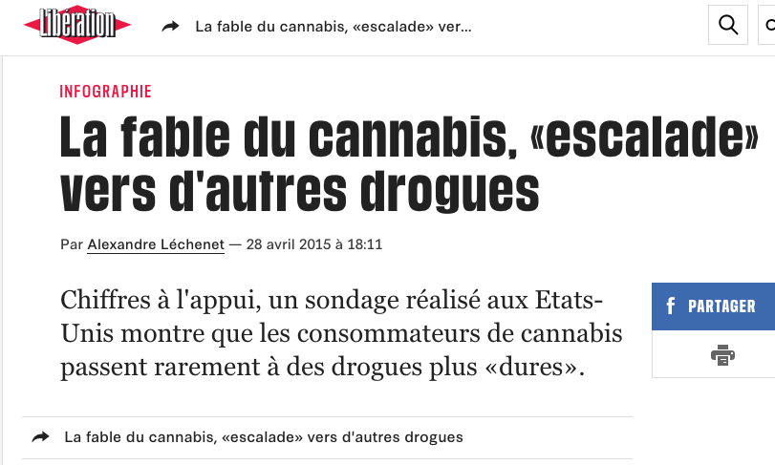
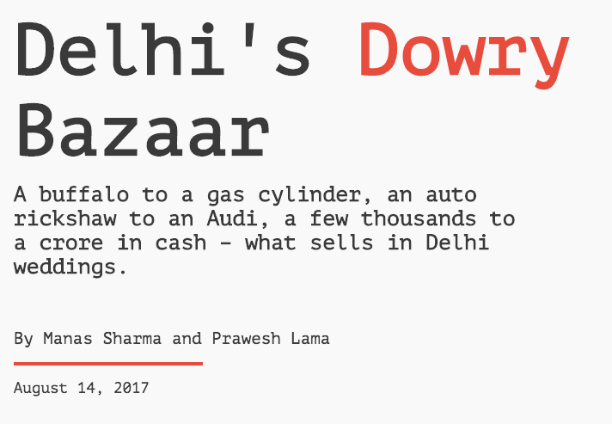

Slide 7
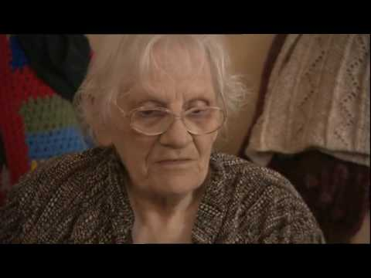


https://onlinejournalismblog.com/2017/06/26/data-journalism-in-broadcast-news-video/

Slide 8
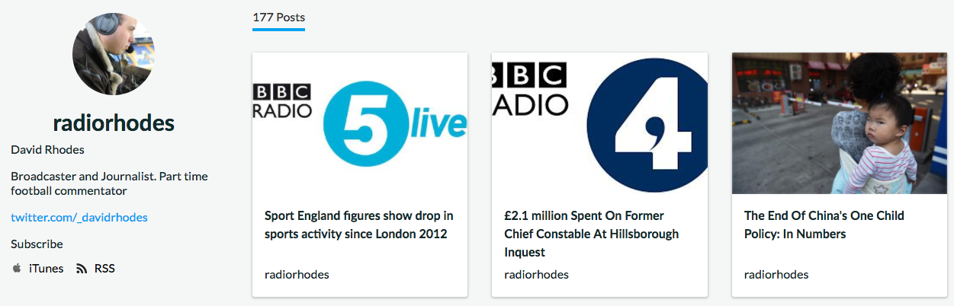
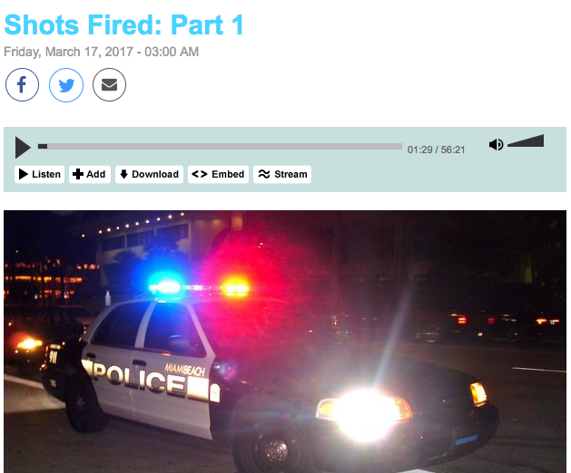
https://audioboom.com/radiorhodes
http://www.radiolab.org/story/shots-fired-part-1/
https://onlinejournalismblog.com/2017/07/06/data-journalism-on-radio-audio-and-podcasts/

Slide 9
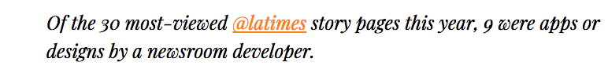
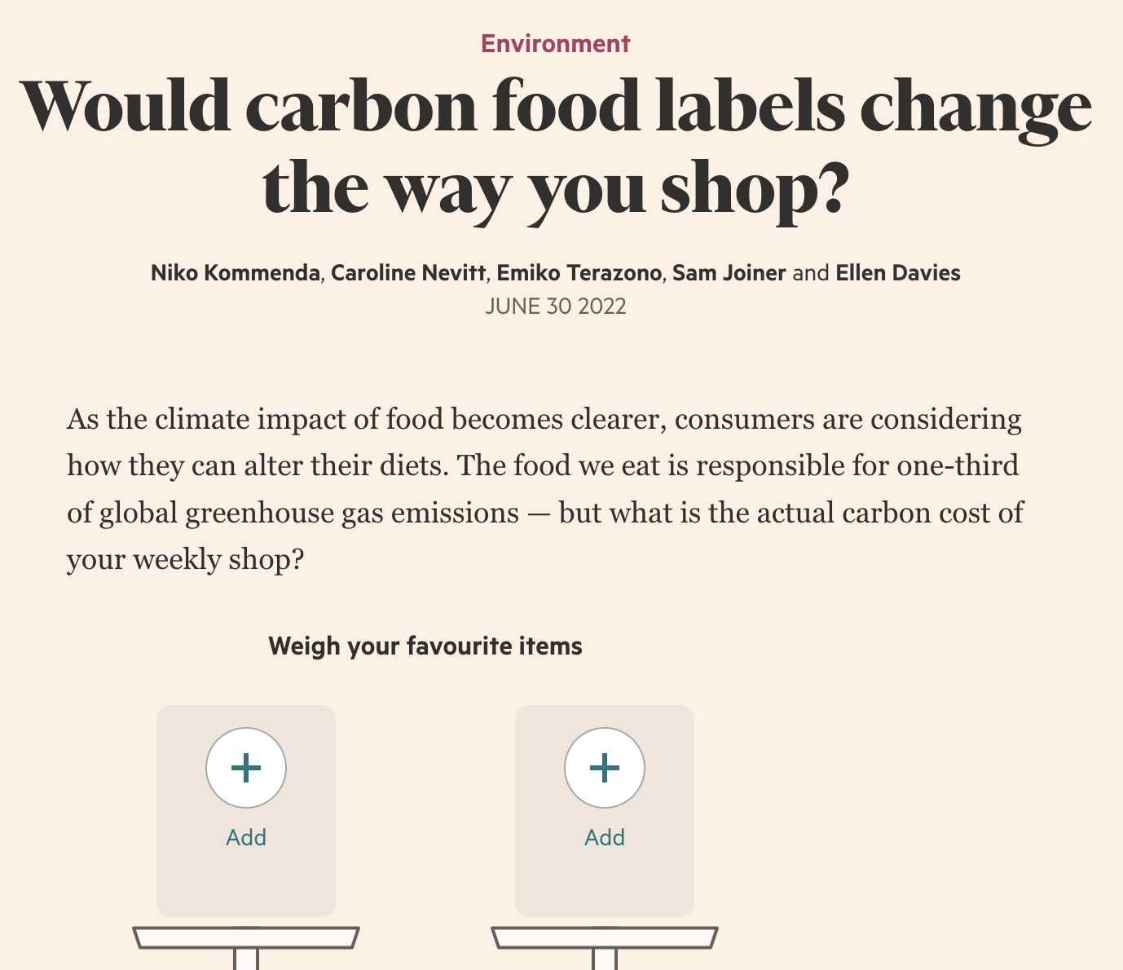
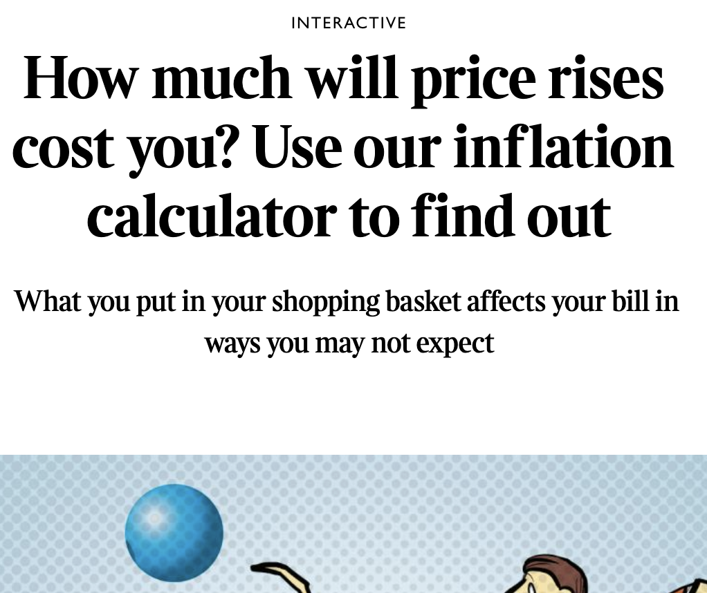
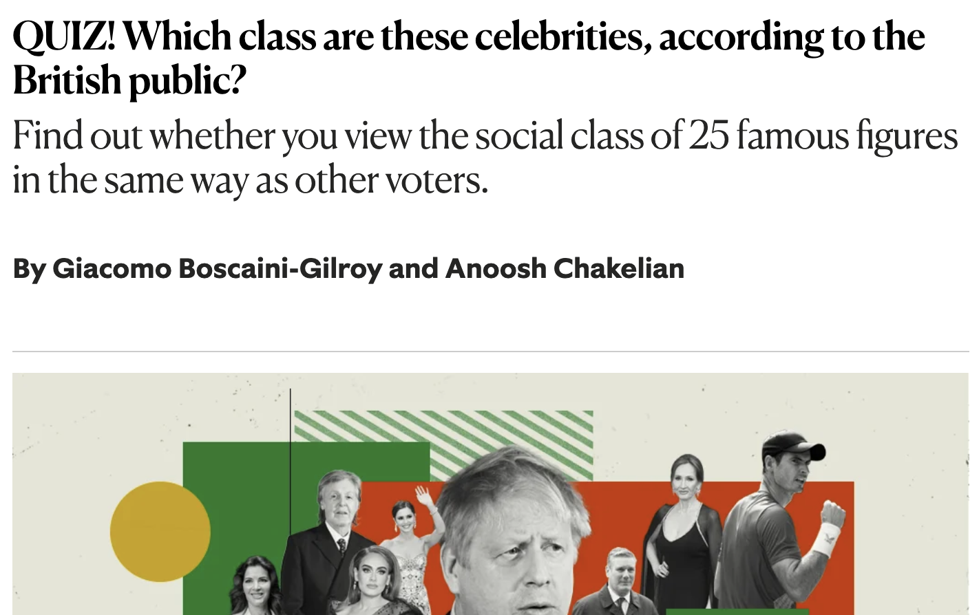


Slide 10
“[A] data journalism artefact is likely but not necessarily a Web-based journalistic piece that is based on data collection and analysis, in other words it cannot be done without data, its essence and core is data. In addition, the main data journalistic approach is quantification.”
Alla Rybina, Operationalization of Data Journalism (DataJ Conf, 2017)

Slide 11

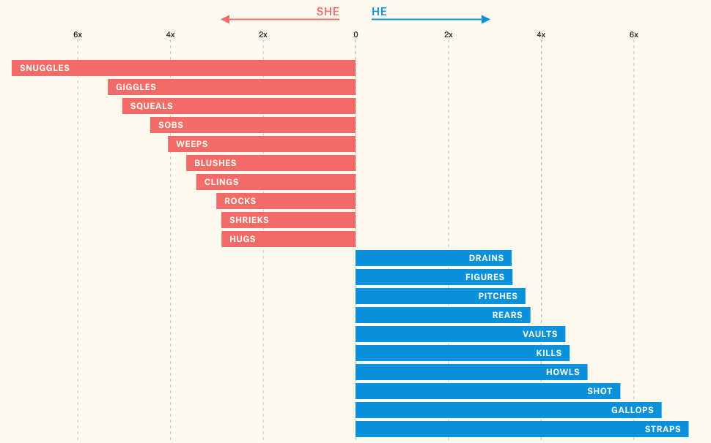
https://pudding.cool/2017/08/screen-direction/ https://github.com/juliasilge/women-in-film

Slide 12
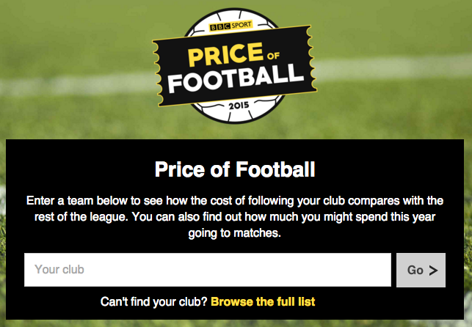
http://www.bbc.co.uk/news/resources/idt-79ccb1e7-d390-44c1-8857-cfcb0ade2595

Slide 13
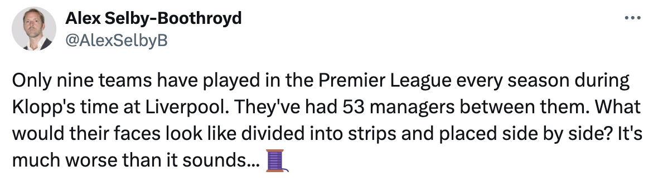

https://x.com/alexselbyb/status/1792174678355714422

Slide 14
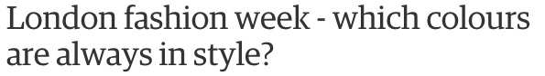
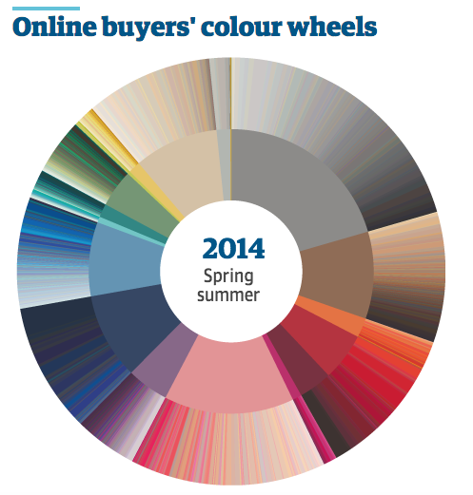
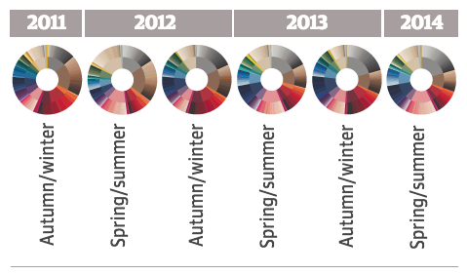
http://www.theguardian.com/news/datablog/ng-interactive/2014/sep/11/london-fashion-week-which-colours-are-always-in-style

Slide 15

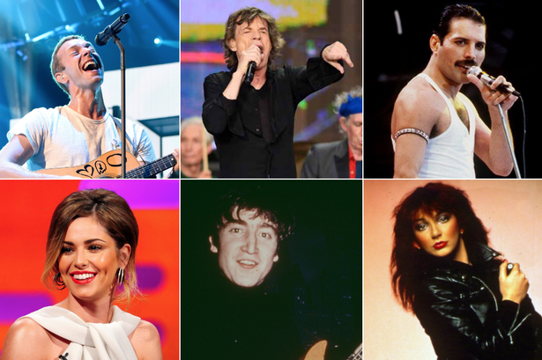
http://www.mirror.co.uk/news/uk-news/singer-best-vocal-range-uk-4323076

Slide 16
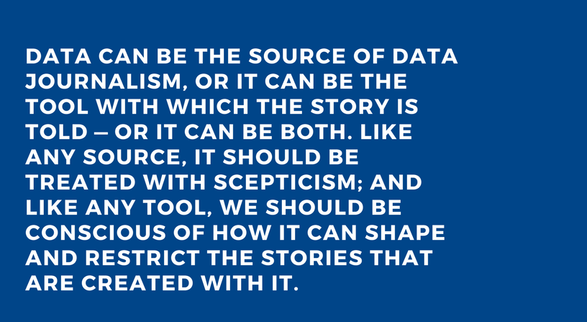
Paul Bradshaw, Data Journalism Handbook http://datajournalismhandbook.org/1.0/en/introduction_0.html

Slide 17
Takeaways:
Data is a core part of journalism
Stand out in the jobs market (especially in sport, music etc.)
Look for data journalism ideas in anything that’s quantifiable (and start simple)

Slide 18
